Slide 1

“
Keeping All Your Balloons in the Air”

Slide 2
Stress…
Researchers define stress as a physical, mental, or emotional response to events that causes bodily or mental tension. Simply put, stress is any outside force or event that has an effect on our body or mind.

Slide 3
Signs of Stress
Physical
  Headache
  Back Pain
  Fatigue
  Aches and Pains
Mental
  Difficulty Concentrating
  Increased Errors
  Poor Decision Making

Slide 4
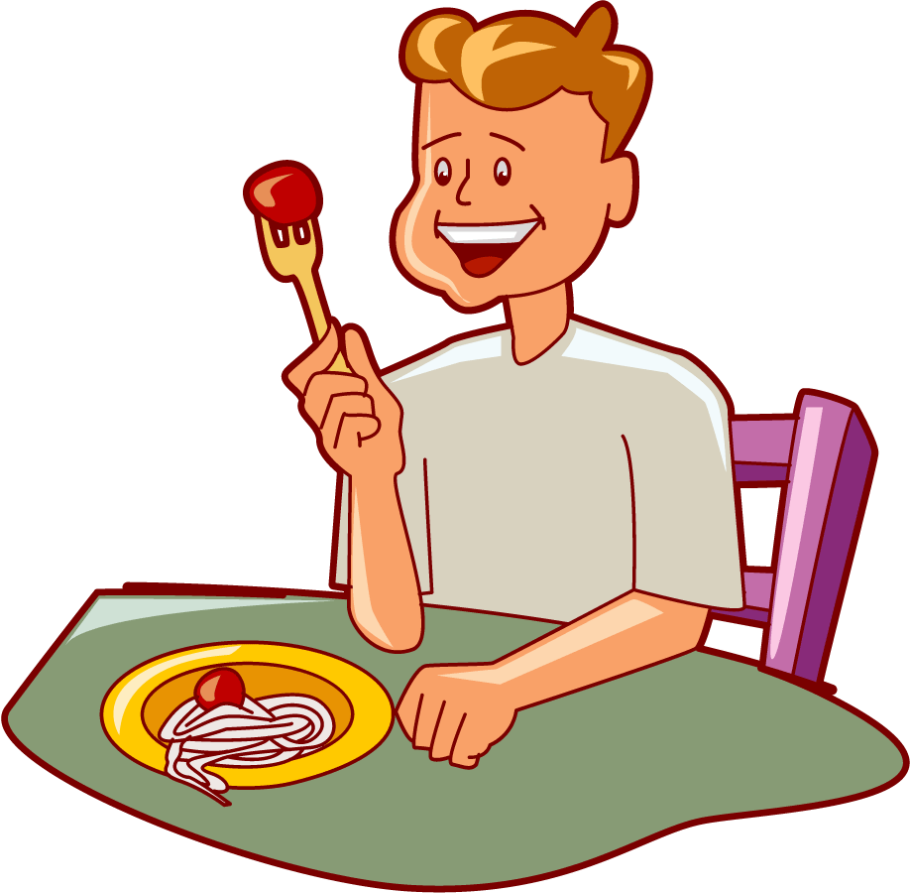
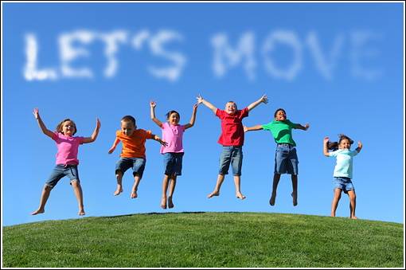
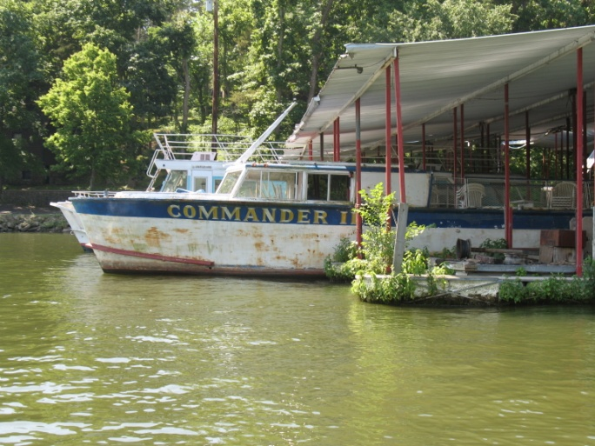
Managing Stress
What is your favorite stress reliever?

Slide 5
How Can We Manage Stress?
Live with an Attitude of Gratitude Be Grateful for what you have.

Slide 6

Time Management
Get organized
Get structured
Set short term goals
Set long term goals
Use a planner:
  daily schedule and “To Do” list

Slide 7
Relaxation
Breathing: practice deep breathing
Progressive muscle relaxation
Guided Imagery
Meditation
Tapes, CDs etc.: Either something structured (commercial) or soothing music
Choose and schedule it in

Slide 8
Cognitive (Thoughts)
Pay attention to what you say to yourself
Identify negative thinking and irrational beliefs
Negative thinking leads to stress and anxiety
Teach thought-stopping techniques
Teach affirmations

Slide 9
One negative thought
leads to another………..
then another………..
then another …..
Pretty soon you have ruined your entire life

Slide 10
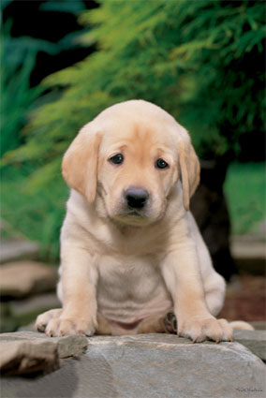

Slide 11
Spirituality
Church, etc
Help others
Spend quiet time every day
Be thankful
Think positively
Put your faith to work!
"I am at peace in the midst of chaos or madness.
No person, place or thing has the power to upset me.".

Slide 12
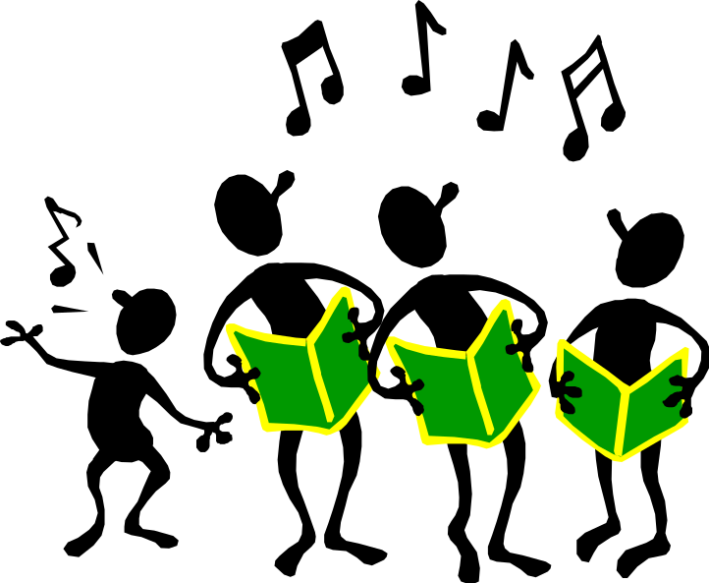
More Ideas…
Laugh Often
Try a New Thing
Cry
Get Enough Sleep
Exercise & Fresh Air
Build a Support System – Friends, Family and Co-Workers
Notes:
Let go of perfectionism
Learn to be Flexiable
Relax your standards
Focus less on plr

Slide 13
Even More Ideas
Let go of perfectionism
Learn to be flexible
Relax your standards
Focus less on pleasing others and more on pleasing yourself
Stay away from negative people
Surround yourself with upbeat, flexible and fun people.

Slide 14
Name Your Stressor
Person
Place
Thing
Combination

Slide 15
Thank you☺

